Slide 1
Recurrent Neural Networks

Slide 2
Recurrent Neural Networks
Human brain deals with information streams. Most data is obtained, processed, and generated sequentially.
  E.g., listening: soundwaves → vocabularies/sentences
  E.g., action: brain signals/instructions → sequential muscle movements
Human thoughts have persistence; humans don’t start their thinking from scratch every second.
  As you read this sentence, you understand each word based on your prior knowledge.
The applications of standard Artificial Neural Networks (and also Convolutional Networks) are limited due to:
  They only accepted a fixed-size vector as input (e.g., an image) and produce a fixed-size vector as output (e.g., probabilities of different classes).
  These models use a fixed amount of computational steps (e.g. the number of layers in the model).

Slide 3
What are recurrent neural networks?
Recurrent Neural Networks (RNNs) are a family of neural networks introduced to learn sequential data.
  Inspired by the temporal-dependent and persistent human thoughts
A recurrent neural network (RNN) is a type of artificial neural network which uses sequential data or time series data.
These deep learning algorithms are commonly used for ordinal or temporal problems, such as language translation, natural language processing (NLP), speech recognition, and image captioning; they are incorporated into popular applications such as Siri, voice search, and Google Translate.

Slide 4
Real-life Sequence Learning Applications
RNNs can be applied to various type of sequential data to learn the temporal patterns.
  Time-series data (e.g., stock price) → Prediction, regression
  Raw sensor data (e.g., signal, voice, handwriting) → Labels or text sequences
  Text → Label (e.g., sentiment) or text sequence (e.g., translation, summary, answer)
  Image and video → Text description (e.g., captions, scene interpretation)

Slide 5
In traditional neural networks, all the inputs and outputs are independent of each other, but in cases when it is required to predict the next word of a sentence, the previous words are required and hence there is a need to remember the previous words.
Thus RNN came into existence, which solved this issue with the help of a Hidden Layer.
The main and most important feature of RNN is its Hidden state, which remembers some information about a sequence. The state is also referred to as Memory State since it remembers the previous input to the network.
It uses the same parameters for each input as it performs the same task on all the inputs or hidden layers to produce the output. This reduces the complexity of parameters, unlike other neural networks.

Slide 6
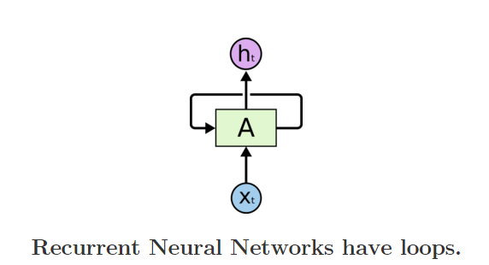
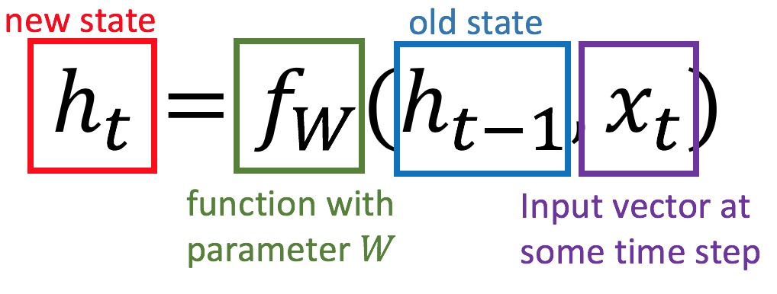
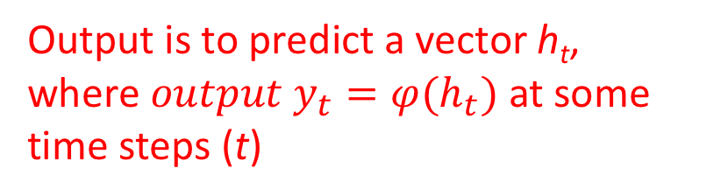
Recurrent Neural Networks
Recurrent Neural Networks are networks with loops, allowing information to persist.
Output is to predict a vector h_{t}, where ${output y}_{t}=φ(h_{t})$ at some time steps (t)
In the above diagram, a chunk of neural network, A = f_{W}, looks at some input xt and outputs a value ht. A loop allows information to be passed from one step of the network to the next.

Slide 7
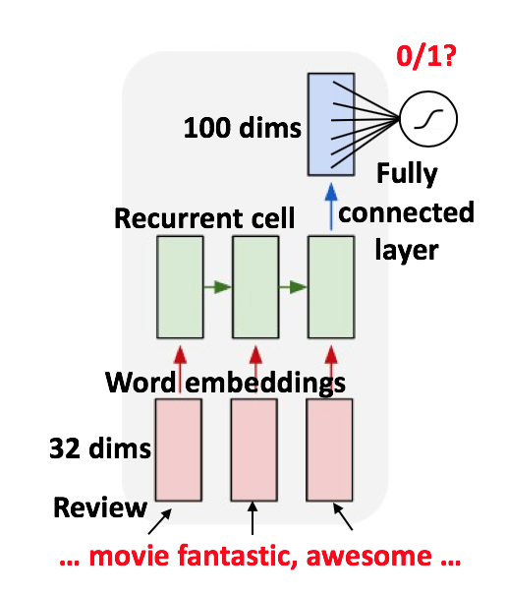





Slide 8
Example
“feeling under the weather”, which is commonly used when someone is ill
In order for the idiom to make sense, it needs to be expressed in that specific order. As a result, recurrent networks need to account for the position of each word in the idiom and they use that information to predict the next word in the sequence.

Slide 9
Like feedforward and convolutional neural networks (CNNs), recurrent neural networks utilize training data to learn.
They are distinguished by their “memory” as they take information from prior inputs to influence the current input and output.
While traditional deep neural networks assume that inputs and outputs are independent of each other, the output of recurrent neural networks depend on the prior elements within the sequence.
While future events would also be helpful in determining the output of a given sequence, unidirectional recurrent neural networks cannot account for these events in their predictions.

Slide 10
Another distinguishing characteristic of recurrent networks is that they share parameters across each layer of the network.
While feedforward networks have different weights across each node, recurrent neural networks share the same weight parameter within each layer of the network.

Slide 11
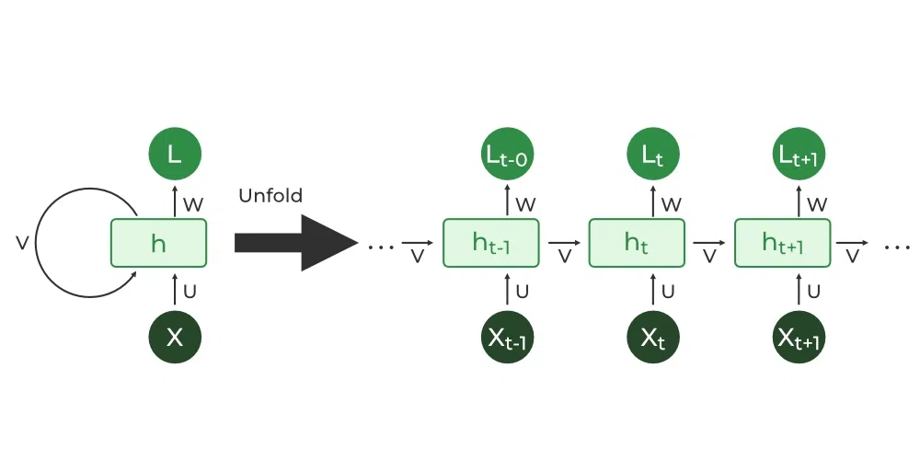
Unrolling/Unfolding
A recurrent neural network can be thought of as multiple copies of the same network, each passing a message to a successor. The diagram above shows what happens if we unroll the loop.

Slide 12
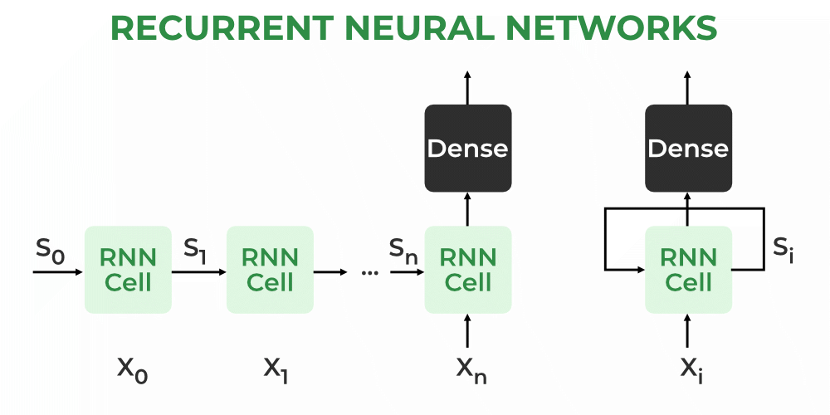

Slide 13
How RNN works
The Recurrent Neural Network consists of multiple fixed activation function units, one for each time step.
Each unit has an internal state which is called the hidden state of the unit.
This hidden state signifies the past knowledge that the network currently holds at a given time step.
This hidden state is updated at every time step to signify the change in the knowledge of the network about the past

Slide 14

The hidden state is updated using the following recurrence relation:-
The formula for calculating the current state:
where:
h_{t} -> current state; h_{t-1} -> previous state; x_{t} -> input state

Slide 15


Formula for applying Activation function(tanh):
where: w_{hh} -> weight at recurrent neuron ; w_{xh} -> weight at input neuron
The formula for calculating output:
Where Y_{t} -> output; W_{hy} -> weight at output layer

Slide 16
These parameters are updated using Backpropagation. However, since RNN works on sequential data here we use an updated backpropagation which is known as Backpropagation through time.
Backpropagation Through Time (BPTT)
In RNN the neural network is in an ordered fashion and since in the ordered network each variable is computed one at a time in a specified order like first h1 then h2 then h3 so on.
Hence we will apply backpropagation throughout all these hidden time states sequentially.

Slide 17
Recurrent neural networks leverage backpropagation through time (BPTT) algorithm to determine the gradients, which is slightly different from traditional backpropagation as it is specific to sequence data.
The principles of BPTT are the same as traditional backpropagation, where the model trains itself by calculating errors from its output layer to its input layer.
These calculations allow us to adjust and fit the parameters of the model appropriately.
BPTT differs from the traditional approach in that BPTT sums errors at each time step whereas feedforward networks do not need to sum errors as they do not share parameters across each layer

Slide 18
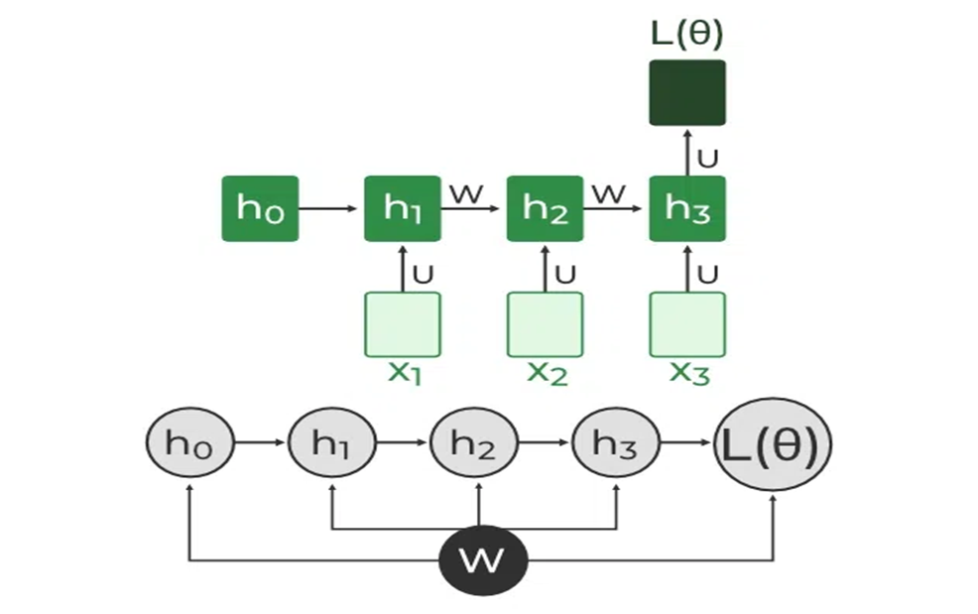

Slide 19
L(θ)(loss function) depends on h3
h3 in turn depends on h2 and W
h2 in turn depends on h1 and W
h1 in turn depends on h0 and W
where h0 is a constant starting state.

Slide 20
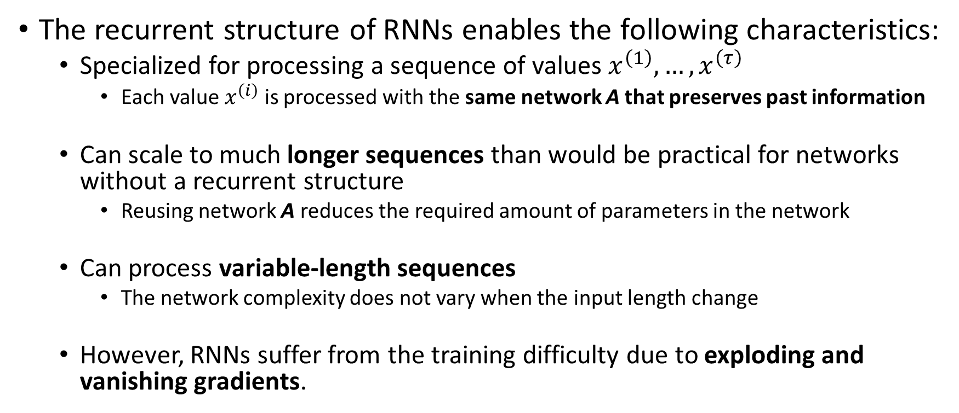
Recurrent Neural Networks
The recurrent structure of RNNs enables the following characteristics:
  Specialized for processing a sequence of values $x^{\left(1\right)}, …, x^{\left(τ\right)}$
    Each value $x^{\left(i\right)}$ is processed with the same network A that preserves past information
  Can scale to much longer sequences than would be practical for networks without a recurrent structure
    Reusing network A reduces the required amount of parameters in the network
  Can process variable-length sequences
    The network complexity does not vary when the input length change
  However, RNNs suffer from the training difficulty due to exploding and vanishing gradients.

Slide 21
These issues are defined by the size of the gradient, which is the slope of the loss function along the error curve.
When the gradient is too small, it continues to become smaller, updating the weight parameters until they become insignificant—i.e. 0. Vanishes.
When that occurs, the algorithm is no longer learning.
Exploding gradients occur when the gradient is too large, creating an unstable model.
In this case, the model weights will grow too large, and they will eventually be represented as NaN. (NaN or Not a Number are special values in DataFrame and numpy arrays that represent the missing of value in a cell. )
One solution to these issues is to reduce the number of hidden layers within the neural network, eliminating some of the complexity in the RNN model.

Slide 22
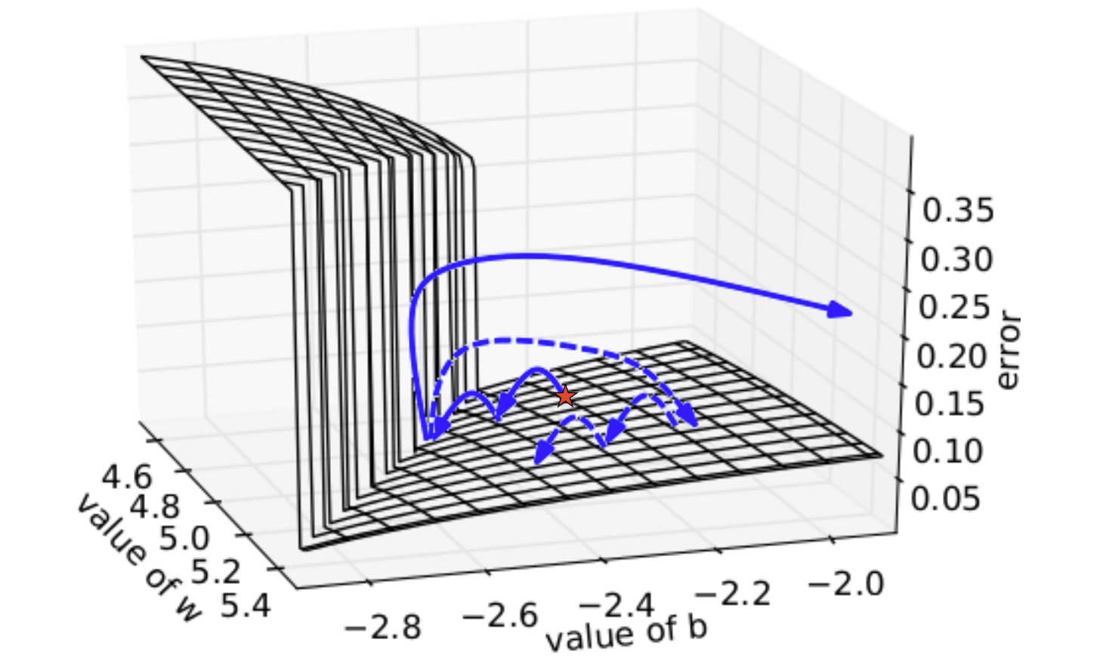
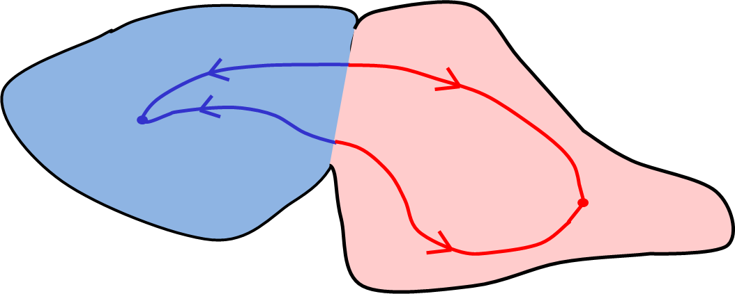
Exploding and Vanishing Gradients
Cliff/boundary
Plane/attractor
Exploding: If we start almost exactly on the boundary (cliff), tiny changes can make a huge difference.
Vanishing: If we start a trajectory within an attractor (plane, flat surface), small changes in where we start make no difference to where we end up.
Both cases hinder the learning process.

Slide 23
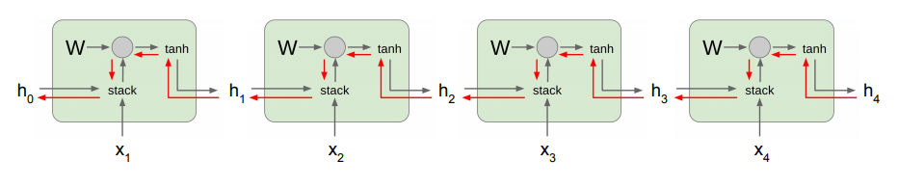
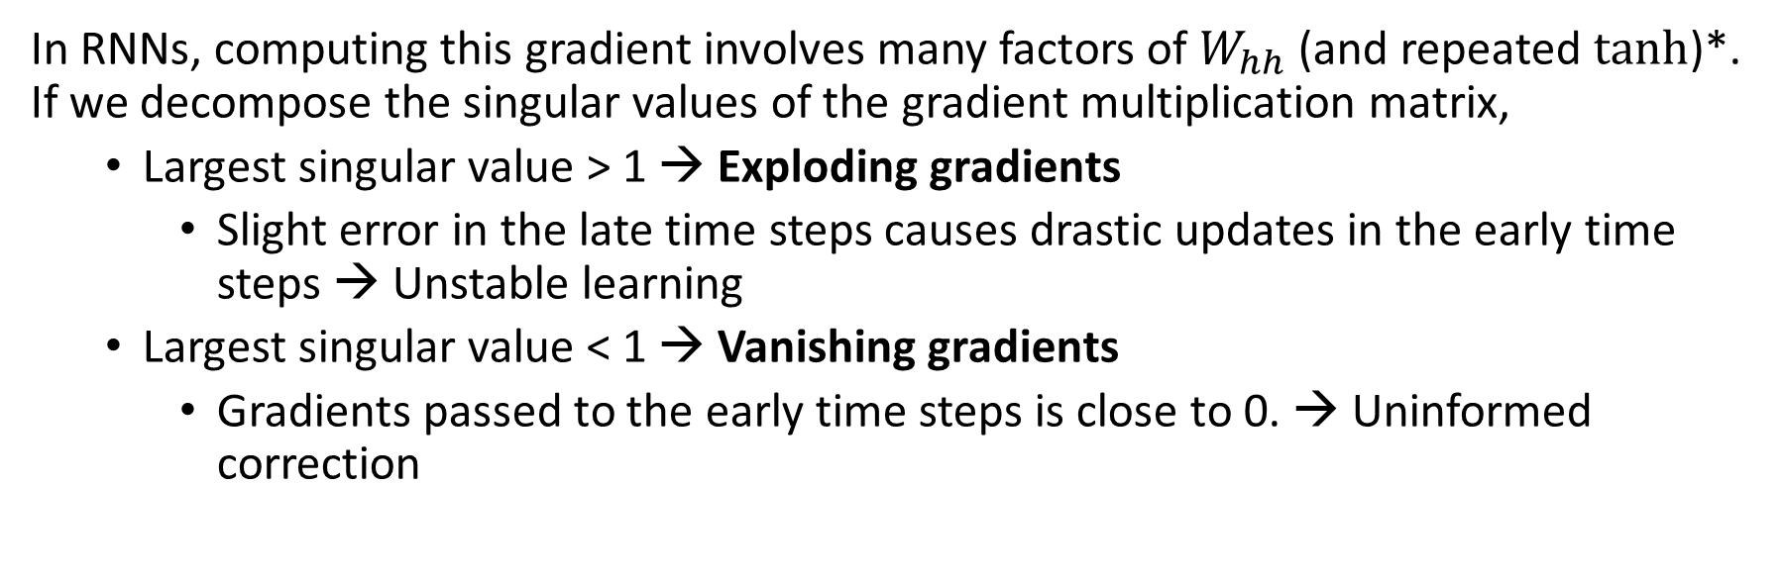

Exploding and Vanishing Gradients
$$E_{4}=J(y_{4}, \hat{y_{4}})$$
In RNNs, computing this gradient involves many factors of $W_{hh}$ (and repeated tanh)*. If we decompose the singular values of the gradient multiplication matrix,
  Largest singular value > 1 → Exploding gradients
    Slight error in the late time steps causes drastic updates in the early time steps → Unstable learning
  Largest singular value < 1 → Vanishing gradients
    Gradients passed to the early time steps is close to 0. → Uninformed correction

Slide 24
Variant RNN architectures
Bidirectional recurrent neural networks (BRNN):
These are a variant network architecture of RNNs.
While unidirectional RNNs can only drawn from previous inputs to make predictions about the current state, bidirectional RNNs pull in future data to improve the accuracy of it.
Consider the example “feeling under the weather”, the model can better predict that the second word in that phrase is “under” if it knew that the last word in the sequence is “weather.”

Slide 25
Long short-term memory (LSTM):
This is a popular RNN architecture, which was introduced by Sepp Hochreiter and Juergen Schmidhuber as a solution to vanishing gradient problem. In their paper, they work to address the problem of long-term dependencies. That is, if the previous state that is influencing the current prediction is not in the recent past, the RNN model may not be able to accurately predict the current state.

Slide 26
Example
“Alice is allergic to nuts. She can’t eat peanut butter.”
The context of a nut allergy can help us anticipate that the food that cannot be eaten contains nuts.
However, if that context was a few sentences prior, then it would make it difficult, or even impossible, for the RNN to connect the information.
To remedy this, LSTMs have “cells” in the hidden layers of the neural network, which have three gates–an input gate, an output gate, and a forget gate.
These gates control the flow of information which is needed to predict the output in the network.
For example, if gender pronouns, such as “she”, was repeated multiple times in prior sentences, you may exclude that from the cell state.

Slide 27
Gated recurrent units (GRUs):
This RNN variant is similar the LSTMs as it also works to address the short-term memory problem of RNN models.
Instead of using a “cell state” regulate information, it uses hidden states, and instead of three gates, it has two—a reset gate and an update gate.
Similar to the gates within LSTMs, the reset and update gates control how much and which information to retain.

